Slide 1

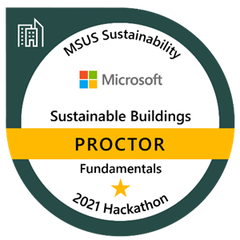
Sustainable Smart Buildings Hackathon
EARN ACCREDITION
BUILD SUSTAINABLE SOLUTIONS
JOIN A COMMUNITY
Earn a Proctor badge in Sustainable Smart Buildings using your data science expertise to mentor teams through a series of challenges on [Date].
Guide participants to develop Proof of Concepts (POC) to address today’s most pressing issues to help reach sustainability goals.
Join a community of sustainability champions to collaborate and share knowledge to build sustainable ecosystem solutions.
Help shape the future of sustainable buildings technology
PROCTOR PREREQUISTITES
Expertise in Python
Experience using Azure Blob Storage, data exploration, and using visualization tools
Knowledge building machine learning models and model explainability, and IoT Sensors Data
Purpose
Drive sustainability fluency among the technical sales teams to build repeatable and customizable 1st party solutions for environmental monitoring, energy consumption, facility operating efficiency, and energy source optimization.
GIVES
Commitment to guide multiple teams in challenges over a three-day event (8 hours each day)
Share best practices related to sustainable smart buildings technology
Help to shape sustainable solutions for real-world use
GETS
Participate in the community of Microsoft Sustainability champions and drive strategy
Earn fundamental badge certification in Sustainable Smart Buildings
Gain deeper knowledge of technical scenarios related to the sustainable ecosystems technology
Hackathon resources
SharePoint site
Sustainable Smart Buildings Hack FAQ
HACKATHON OUTCOMES
Guide developing POC 1st party solutions
Programmatic up-skilling motion
REGISTRATION SITE
Badging gamification

